Slide 1
Outreach Best Practices ADL Initiative
Andy Johnson and Anne Marie DiNardo (SETA Contractors)

Slide 2


How We Align
Office of the Secretary of Defense
Operational Oversight
Secondary Reporting for Policy Oversight
USD Personnel and Readiness (USD(P&R))
Hon. Gil Cisneros
Defense Human Resources Activity (DHRA) Bill Booth, SES, Director
ASD Readiness
Hon. Shawn Skelly
Defense Support Services Center (DSSC) Bill Mansell, SES, Director
DASD Force Education and Training
Caroline Baxter
Part of the Defense Activity for Non-Traditional Education Support (Jeff Allen, Director) under DSSC
Dr. Sae Schatz
Director (CIV)
Dr. Laura Milham
Air Force LNO / Deputy
Dr. Karen Cooper
Navy LNO / R&D Support

Slide 3
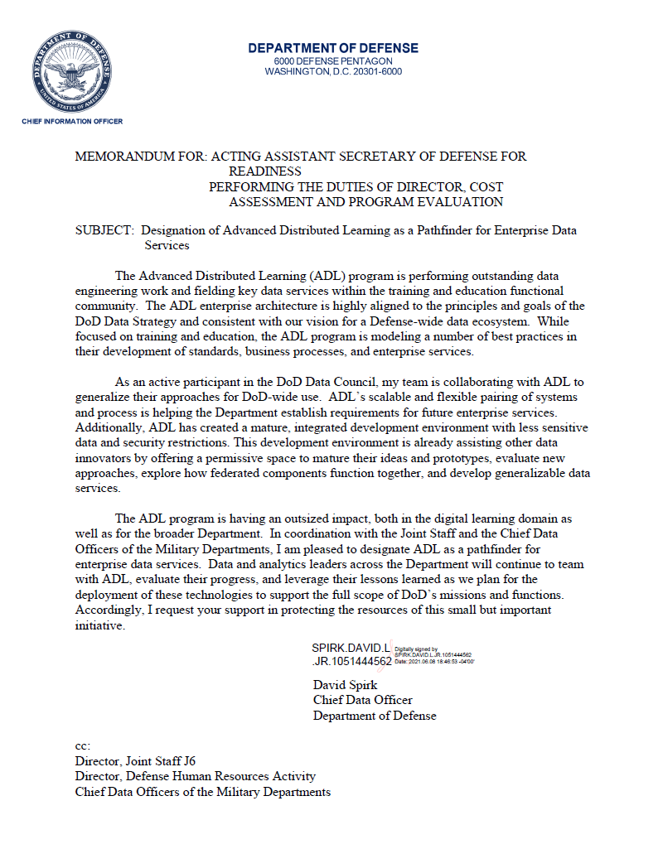
The ADL enterprise architecture is highly aligned to the principles and goals of the DoD Data Strategy and consistent with our vision for a Defense-wide data ecosystem. While focused on training and education, the ADL program is modeling a number of best practices in their development of standards, business processes, and enterprise services.
ADL has created a mature, integrated development environment…
I am pleased to designate ADL as a pathfinder for
enterprise data services.
Dave Spirk,
DoD Chief Data Officer
08 June 2021

Slide 4
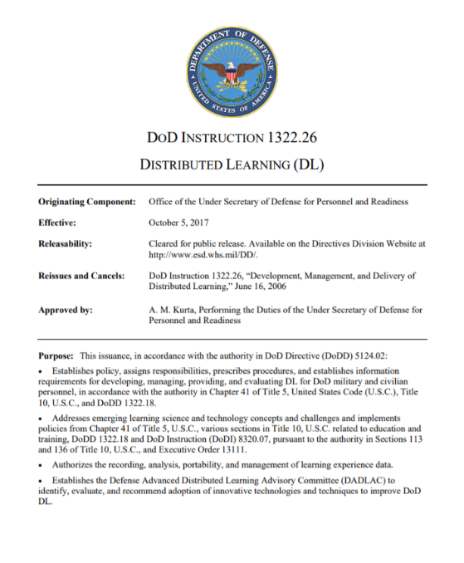
About the ADL Initiative
PROGRAM: Advanced Distributed Learning (ADL)
DIRECTOR: Sae Schatz, Ph.D. (CIV)
CHAIN OF COMMAND: Defense Human Resources Activity (DHRA)
PURPOSE: Facilitate interoperability and promote best practices for Distributed Learning (DL)…
LINES OF EFFORT:
Modernization: R&D for DL
Documentation: Policy, specs, and standards for DL
Coordination: Facilitate DoD, Coalition, S&T groups
DoDI 1322.26: “The ADL Initiative is the principal steward for researching and facilitating the implementation of DL standards, specifications, and emerging technologies for DoD Components.”
4

Slide 5

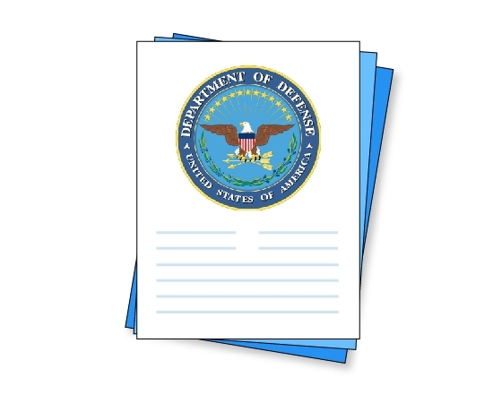

Lines of Effort

Slide 6
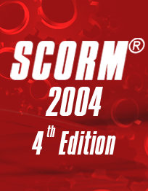
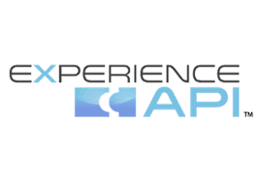
Our Research and Development Work
FUNDED RESEARCH PROJECTS: Total Learning Architecture, Enterprise Course Catalog, other modernization efforts
COMMITMENT TO OPEN SOURCE: All ADL Initiative efforts are open source and widely shared – use of GitHub, Creative Commons licenses
CHAMPION OF SPECS AND STANDARDS: Developed SCORM® (ISO) and xAPI (IEEE), collaborated with Standards Development Organizations on many others and to standardize SCORM/xAPI
OUR WORK INFLUENCES:
Industry: Products, Services, Contractors
Academia: Research and Adoption
Government: Whole of Government and International
6

Slide 7
Policy Influence via Department of Defense Instruction
THE DODI: Provides specific guidance on acquisition and use of Distributed Learning
REFERENCE UPDATES: DoDI links out to a "living document" at https://adlnet.gov/policy/fungible/
GROWING OVER TIME: The original DoDI included only SCORM specifics, then added xAPI, and has added many more specs, standards, concepts, and requirements
UPDATES EXECUTED BY A WORKING GROUP: The DoDI is updated twice annually and is done by a process of collective requirements gathering, edits, feedback, and voting.
7

Slide 8
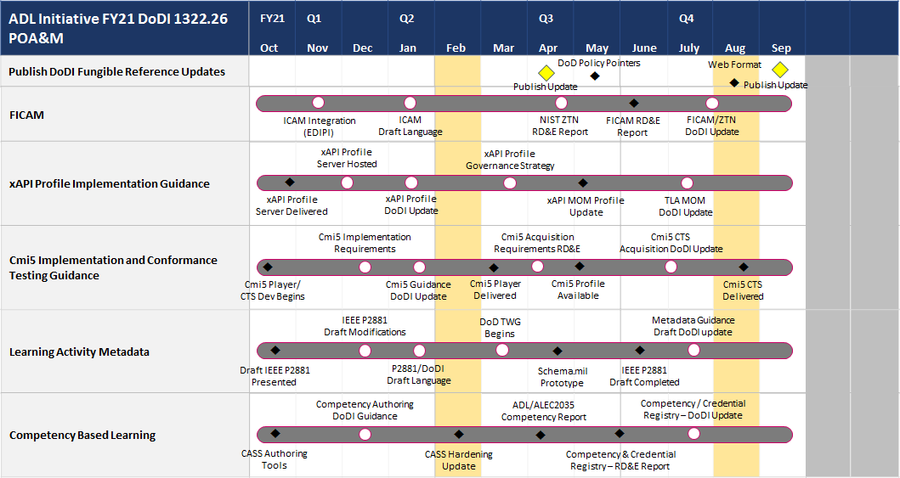
A Year in the Life of the DoDI (They Grow Up So Fast)
8

Slide 9
Lines of Effort
[Outreach] Overcome the research–practice gap by “diffusing innovation” through communication, customer service, and community leadership Supporting Tasks:
Strategic Messaging: Create and execute strategic communications plan
Facilitating Adoption: Facilitate early adoption of ADL innovations
Building Community: Foster collaborative communities around ADL

Slide 10
Outreach Organizational Structure
Principal
Community Manager(s)
Outreach Integrator
Technical Writer/ Editor
Website Administrator
Graphic Designer Photographer Videographer
Meetings and Events Coordinator
Protocol Specialist

Slide 11
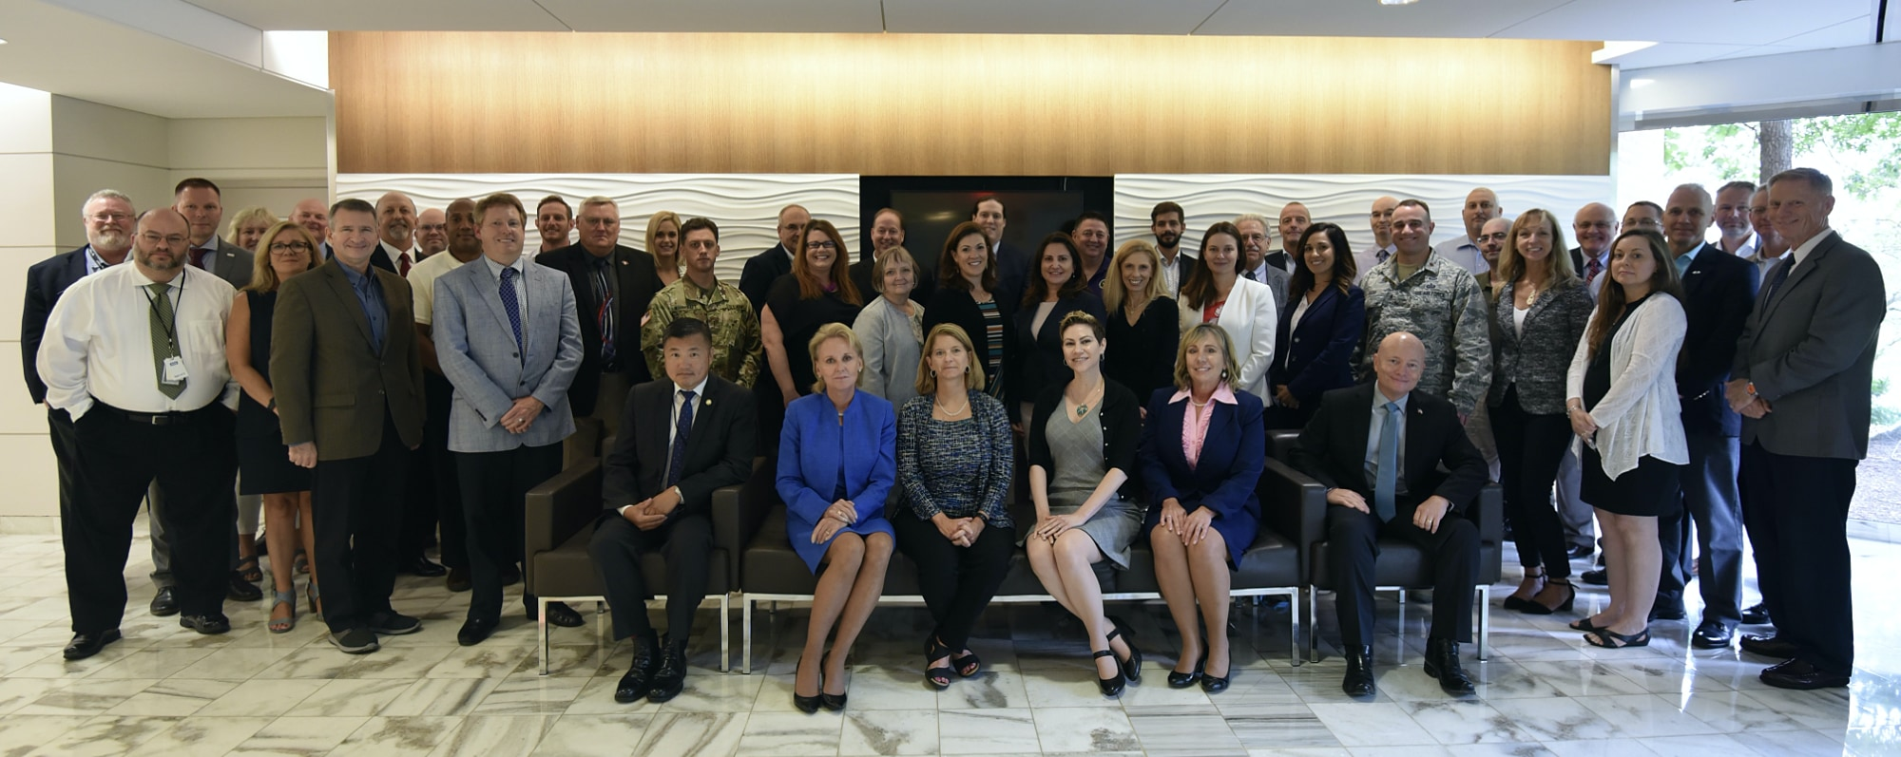
Outreach Use Cases
Defense ADL Advisory Committee
Building a network as a key component in achieving the vision
Key Tactics
Annual Report
Informative email updates
Open forum exchanges
Signature Events
Lessons Learned
Choose tools that are needed
Experiment with formats
Be responsive, present, and persistent
Prep speakers

Slide 12
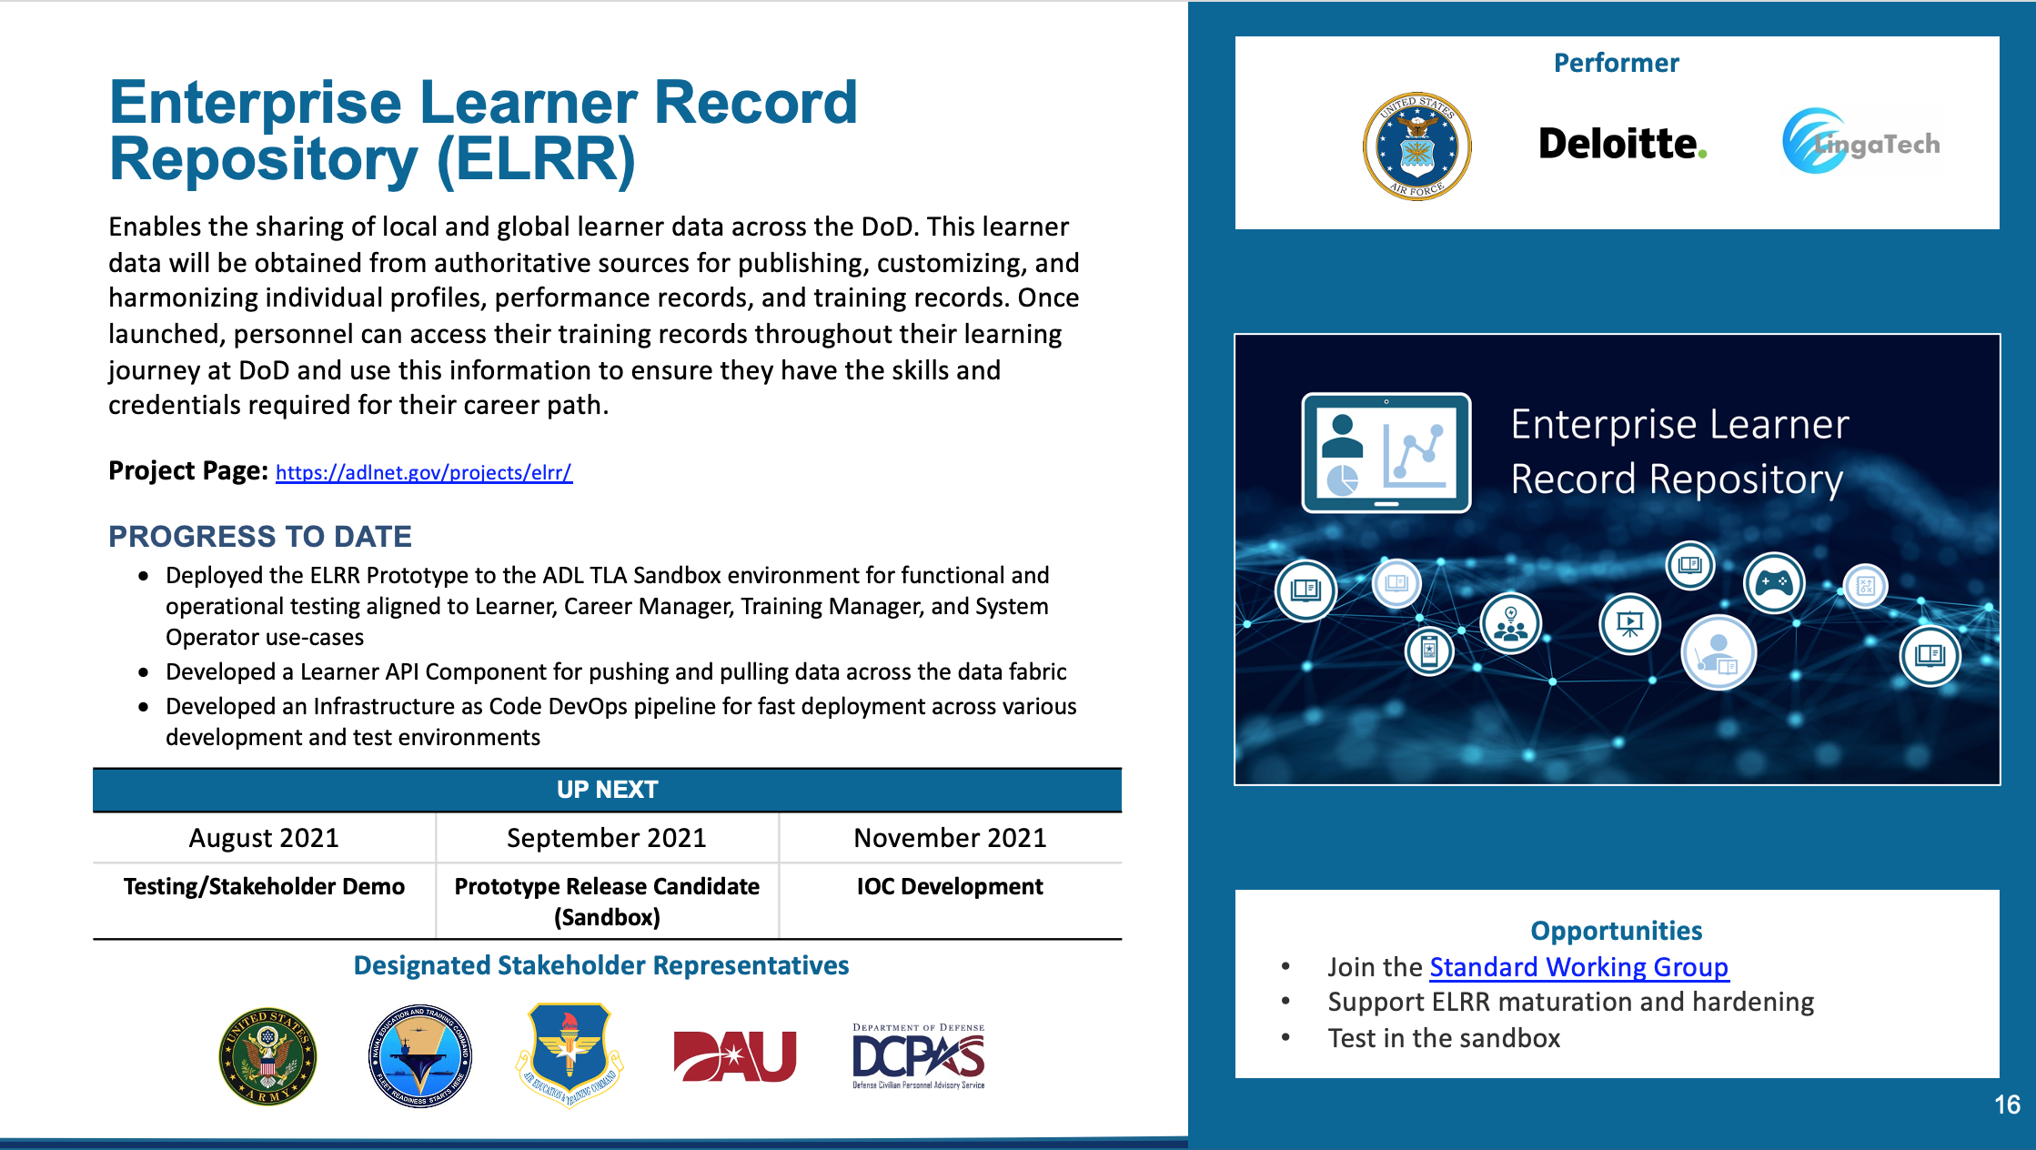
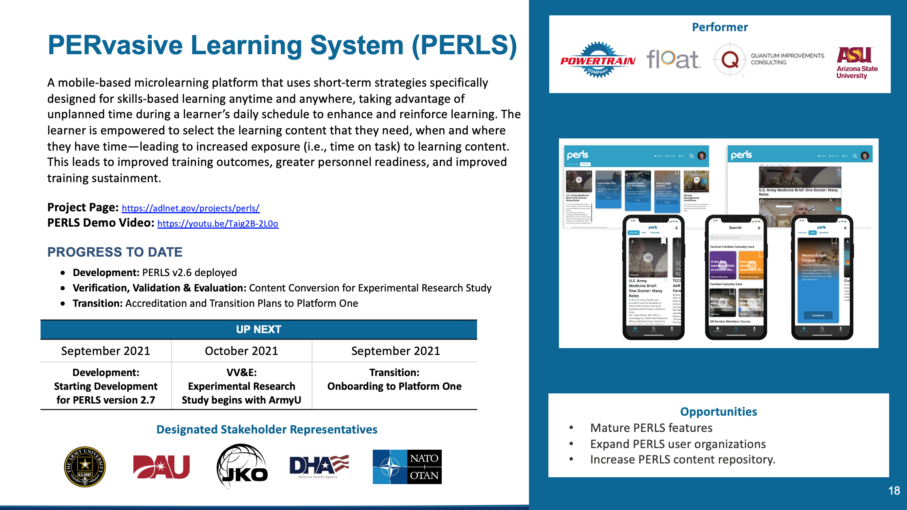
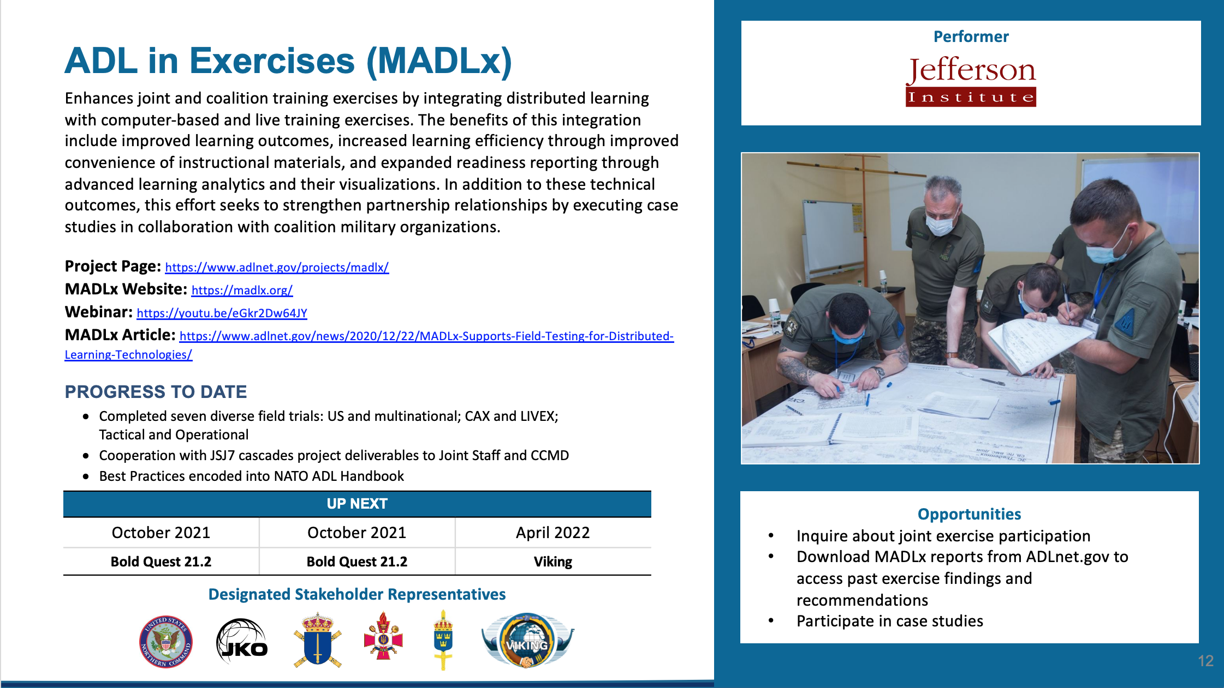
Outreach Use Cases
R&D Project Portfolio
Telling a compelling story using an integrated messaging approach
Key Tactics
Project Pages
Articles
Webinars
Signature Event
Lessons Learned
Keep information relevant
Track opportunities
Consistent messaging

Slide 13
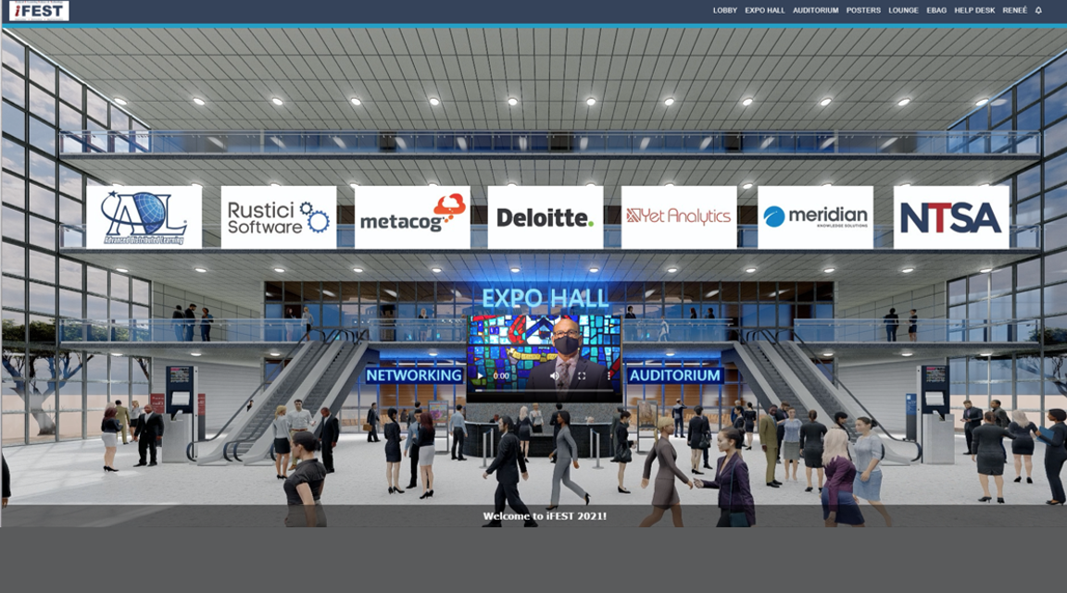
Outreach Use Cases
iFEST
Leveraging events to achieve multiple communications objectives
Key Tactics
Presentations
Regular announcements
Social media
Exhibits
Fun activities
Posters
Lessons Learned
Focus on the attendee experience
Be flexible
Plan ahead with effective tracking tools

Slide 14








Key Tips
Start with Your Desired Outcomes
Start with Your Desired Outcomes
Know Your Program
Know Your Program
Know Your Stakeholders
Know Your Stakeholders
Comprehensive Plan (A-Z, not A-R)
Comprehensive Plan (A-Z, not A-R)
Determine Stakeholder Value Proposition
Determine Stakeholder Value Proposition
One Message and One Technique Does Not Fit All
One Message and One Technique Does Not Fit All
Be Consistent and Responsive
Be Consistent and Responsive
Networks and Networking is Critical
Networks and Networking is Critical

Slide 15
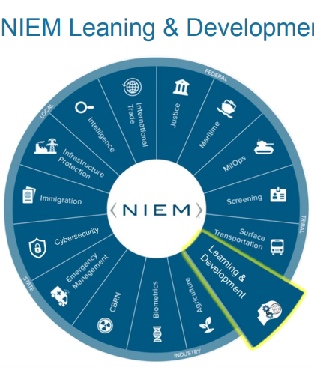
Enabling a NIEM Learning & Development Domain

Slide 16
Implementing Best Practices
NIEM’s rich data model is lacking in coverage of key learning standards
ADL Initiative, as a policy steward and pathfinder, would like to bridge this gap
ADL Initiative already spearheaded the creation of multiple standards (e.g., SCORM®, xAPI) and has a history of involvement with Standards Development Organizations (e.g., IEEE, IMS Global, ISO, PESC, HR Open)
ADL Initiative chairs the Joint Enterprise Standards Committee (JESC) Applications Technical Working Group

Slide 17
Value Proposition
Learning and Development COI
Best practice model to align existing learning and development data standards with DoD and external stakeholders
Promotes community-based agreement on data element names and definitions
Supports reuse of definitions within concrete, implementable data syntaxes
Provides a framework for information exchange specifications with machine-testable conformance
Improves interoperability – making data visible, accessible, and understandable enterprise-wide
NIEM Community
Increases use of a common and standard data and information sharing model for learning and development
Using NIEM increases interoperability within the DoD and other federal, state, local, and tribal entities
Reduces development and maintenance costs for any entity seeking information sharing links
Learning and Development Domain broadens accessibility of information to the NIEM community

Slide 18
Proposed Organization Chart Learning & Development Domain
TBD Co-Chair TBD
Dr. Sae Schatz Steward Chair ADL Initiative
TBD Co-Chair TBD
Andy Johnson Facilitator ADL Initiative
Volunteer Tech. Support TBD
Volunteer Com. Support TBD
Members Gen. Support TBD
18

Slide 19

Questions/Comments
Andy Johnson
Specifications and Standards Manager
Andy.Johnson.ctr@ADLnet.gov
Anne Marie DiNardo
Outreach Integrator DADLAC Community Manager AnneMarie.DiNardo.ctr@ADLnet.gov

